Slide 1

CivicPulse
AI‑First Civic Intelligence for Smarter Cities — VEGA Hackathon 2026
A clean, secure platform that turns citizen photos into actionable municipal reports. Futuristic, government‑grade UX focused on transparency, speed and measurable civic impact.

Slide 2



The Problem
Citizen friction
Administrative overload
Transparency gap
Long forms, typing barriers, poor tracking — low completion and trust.
Citizens can’t follow progress; municipalities lack real‑time situational awareness.
Manual triage, duplicated entries and slow response cycles waste resources.

Slide 3

The Opportunity
70%+ of residents carry smartphones — image reporting is natural and immediate.
AI can auto‑classify issue type, severity and responsible department in seconds.
Real‑time dashboards and heatmaps increase municipal responsiveness and public trust.
Impact lens: faster resolution, fewer duplicate submissions and measurable improvements in civic engagement.

Slide 4

The Solution — CivicPulse
For Citizens
For Municipalities
Photo upload + GPS auto-capture
AI generates title, description, department, severity
One‑click submit & live status tracking
AI‑generated "Mayor’s Briefing" summaries
Realtime triage dashboard and heatmap
Role‑based workflows and audit trails

Slide 5

Zero‑Typing AI Flow — Citizen Journey
Upload
Pre‑filled
Live Status
Citizen adds a photo
Title, description, dept, severity
Real‑time updates for citizen
One‑Tap Submit
AI Extracts
Detects location and class
Send report in ~10 seconds
From photo to report in ~10 seconds. Minimal friction increases reporting rates and data quality.

Slide 6
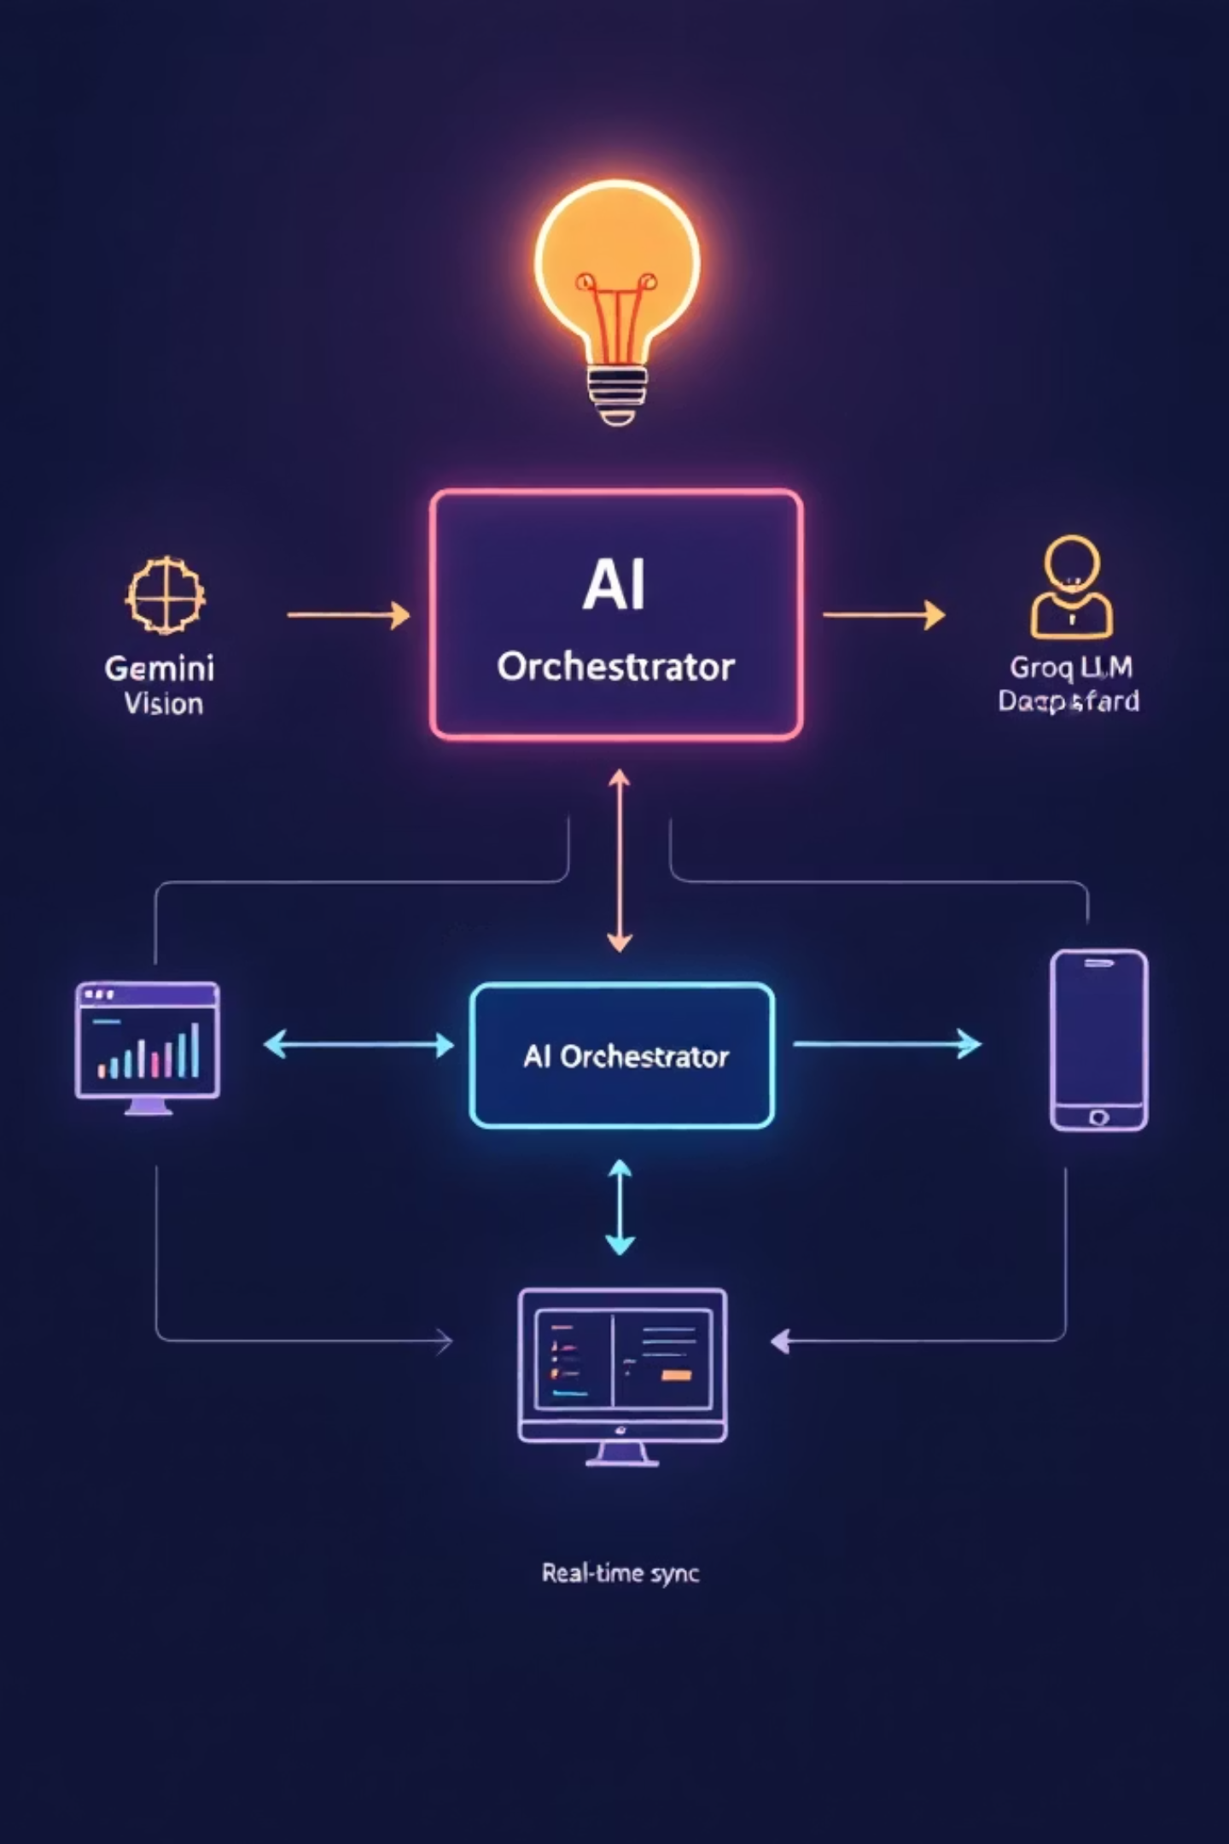



AI Architecture (High Level)
Frontend → Supabase (Auth, DB, Storage, Realtime) → Edge AI Orchestrator → Gemini Vision (image understanding) → Groq LLM (summaries & triage)
Privacy-first
Secure server‑side AI calls and fallback caching for demo reliability
Geo accuracy via image EXIF + client GPS
Realtime sync using Supabase Realtime for instant updates
Minimise PII, encrypted storage, audit logs for accountability.
Resilient
Edge inference + queued fallbacks keep triage available under load.
Accurate geo-tagging
Combines device GPS with image metadata to pinpoint issues.

Slide 7
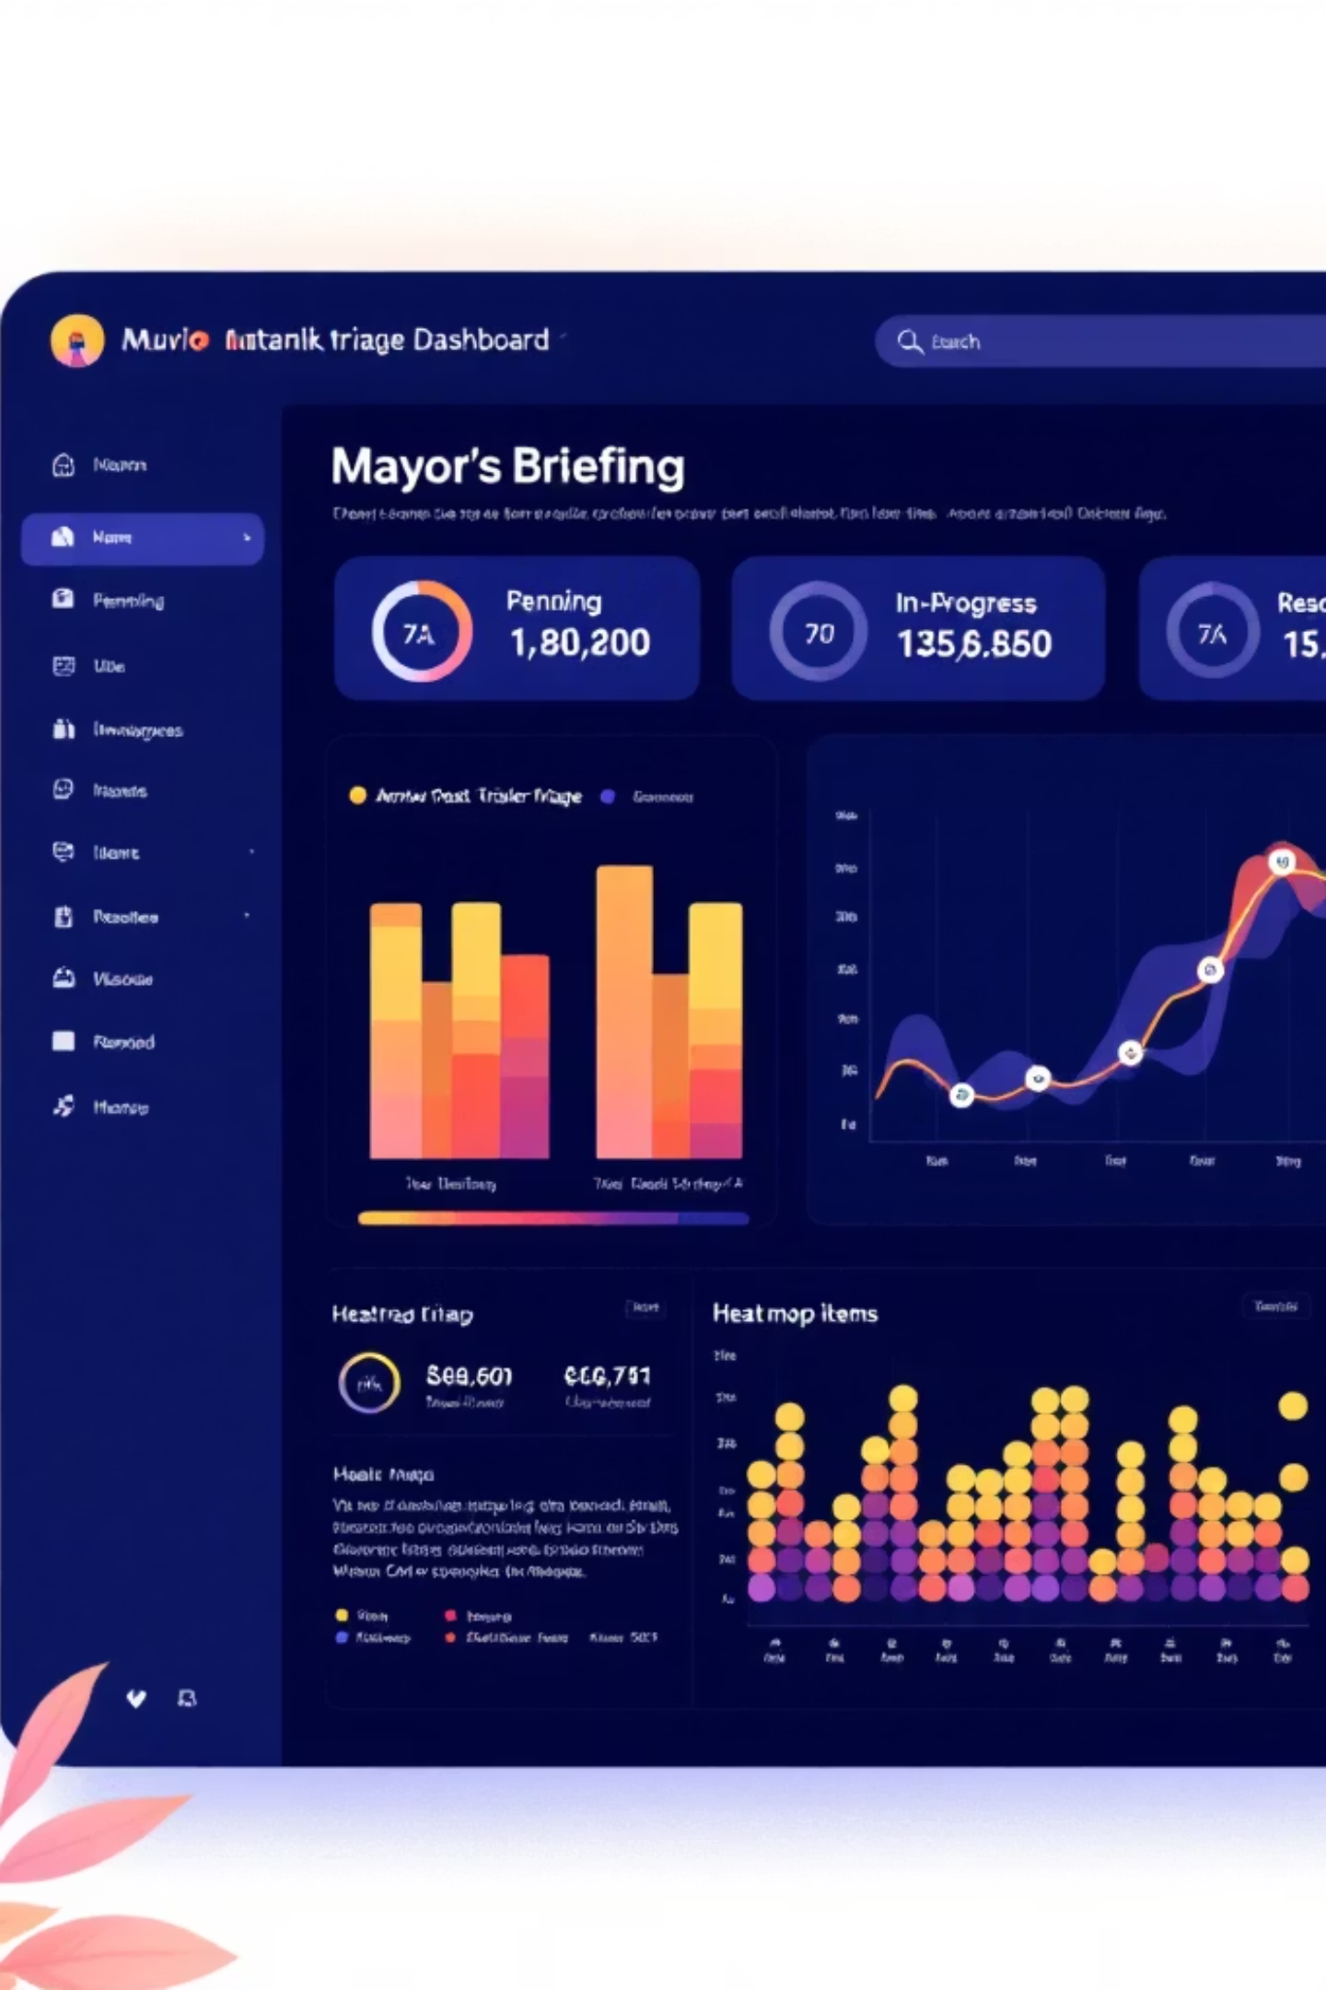
Admin Triage Dashboard
1
2
3
AI Mayor’s Briefing
Live Metrics
Heatmap Management
Pending / In progress / Resolved counters with trend indicators.
At‑a‑glance summary of critical incidents and suggested actions.
Cluster detection to prioritise field crews and resource allocation.

Slide 8

Realtime Transparency & Citizen Trust
Admin updates status → Citizen sees instant badge update. Realtime sync builds confidence and reduces enquiry volume.
Audit trail for accountability
Inline comments and photo updates from crews
Public dashboard slices for aggregated KPIs

Slide 9

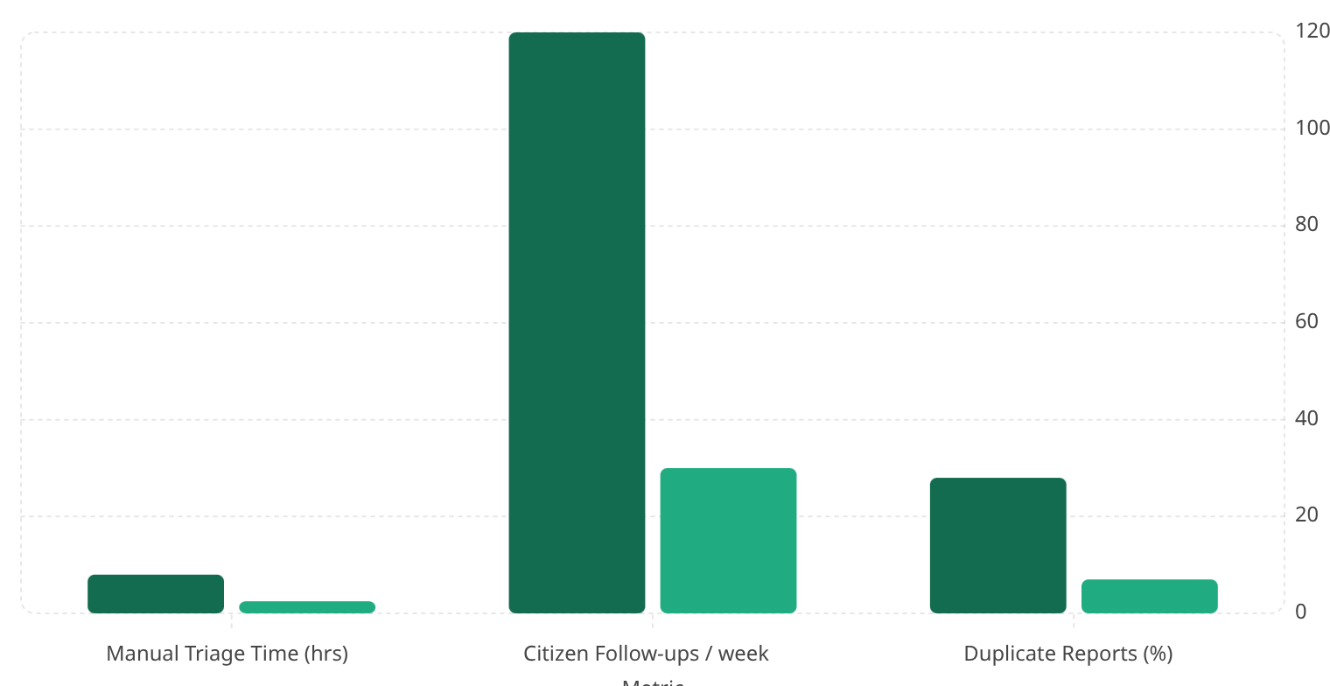



Technical Stack & Impact Metrics
Baseline
With CivicPulse
Supabase
Auth, storage, realtime and scalable Postgres data store.
Langflow + Gemini Vision
Robust image understanding and semantic classification.
Groq LLM
Concise triage summaries and Mayor‑level briefings.
Leaflet Maps
Lightweight, embeddable heatmaps and clustering for field ops.

Slide 10




Next Steps & Why This Wins
Why This Wins
AI‑first governance, measurable 70% reduction in manual effort, improved engagement and transparent issue lifecycle.
Roadmap
Multilingual support → Predictive failure detection → ERP integrations → Budget insights for prioritized repairs.
Demo
Scan the QR placeholder to access the live demo and prototype walkthrough.
CivicPulse — Powering transparent governance with AI. Thank you — ready for the live demo and Q&A.

